Slide 1
Here is where our presentation begins.
You are Welcome!!!!

Slide 2


REPUBLIC OF CAMEROON
Peace - Work - Fatherland
REPUBLIQUE DU CAMEROUN
Paix – Travail - Patrie
AFRICAN INSTITUTE OF COMPUTER SCIENCES - CAMEROON OFFICE
PAUL BIYA TECHNOLOGICAL CENTER OF EXCELLENCE
P.O. Box: 13719 Yaoundé
Tel: +237.242.729.957 Fax: 22729958
E-mail: contact@iaicameroun.com
Web site: www.iaicameroun.com
REALIZE
Tel: (237) 620256960/654486985
Email : realize.contactus@gmail.com
Web site: www.realize.cm
THEME:DESIGN AND IMPLEMENTATION OF AN AI-ASSISTED PHARMACY STOCK MANAGEMENT PLATFORM WITH GEOLOCATION-BASED DRUG SEARCH AND DELIVERY SERVICE
Internship carried out from the 01st of July till the 30th of September 2026. In view of obtaining a Software Engineering Diploma in Computer Sciences Option: Software Engineering
Written by:
NSAN SAMUEL PENIEL
Level III Software Engineering Student
Academic Supervisor:
Mr. ASANE DERICK
Lecturer at AICS-Cameroon
Supervision
Professional Supervisor:
Mr. MENGOT NSO
Software Engineer
Academic Year 2025 - 2026

Slide 3
Presentation Plan
01
Introduction
02
Context and Problematic
03
Methodology
04
Demonstration
05
Conclusion

Slide 4
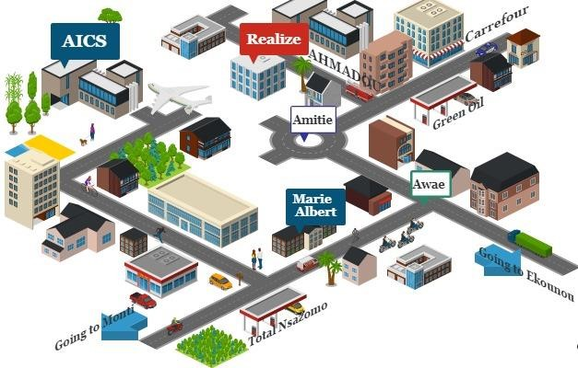
GENERAL PRESENTATION OF REALIZE
GEOGRAHICAL LOCATION
A. History
Realize is a Cameroon-based NGO and tech start-up founded by Mr. NDELOGAKEH DANIEL in 2022. It offers IT solutions and promotes the use of new technologies in Cameroon.
B. Vision
Realize believes that unlocking the potential of organizations and individuals is possible through analysis, development, realization, and data analytics.
REALIZE is located at Yaoundé Valler Amadou Ekie

Slide 5
Challenges in Accessing Medicines and Pharmacy Services
CONTEXT / STATISTICS
Problem breakdown percentages:
Medicine unavailability — 47%
Medicine price — 36%
Serious access problems — 10%
Access to medicines in local pharmacies — 84%
Access to medicines remains a challenge, particularly when medicines are unavailable at the pharmacy or considered too expensive. Approximately 1200-1500pharmacies are in cameroon MINSANTE 2023.
Medicine availability and accessibility remain important challenges, creating a need for better visibility of pharmacy stocks and easier access to nearby pharmacies.

Slide 6
Consequences of limited access to medicines and pharmacies
1
Treatment interruption
Difficulty finding replacement medicines can interrupt an ongoing treatment.
Worsening health conditions
Delays in obtaining essential medicines may worsen certain illnesses or complicate recovery.
2
3
Difficulty for vulnerable individuals
Elderly people, persons with disabilities and people with limited mobility may experience greater difficulties accessing pharmacies.
Clients may have to visit several pharmacies to find the required medicine, resulting in additional transportation expenses.
4
Increased transportation costs

Slide 7
CONTEXT (HISTORY)
Challenges in Accessing Medicines and Pharmacy Services
1. Difficulty Finding Medicines
Difficulty identifying pharmacies that have the required medicine
Lack of centralized information on medicine availability
Time wasted visiting several pharmacies
2. Stock and Access Challenges
Pharmacy stock information may not be visible to clients
Medicine availability can change rapidly
Difficulty verifying actual availability before visiting
3. Service and Delivery Challenges
Limited convenient options for medicine pickup or delivery
Difficulty locating nearby pharmacies and planning routes
Lack of integrated order and delivery management

Slide 8
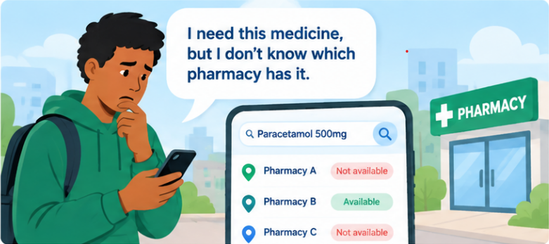
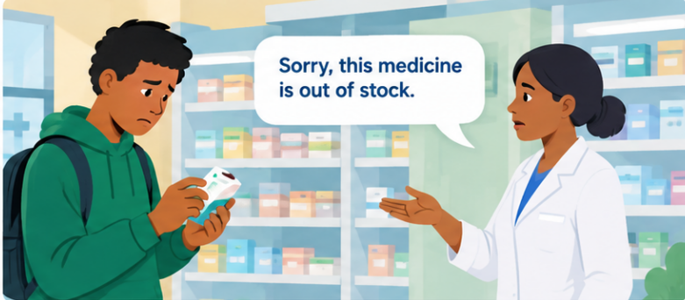
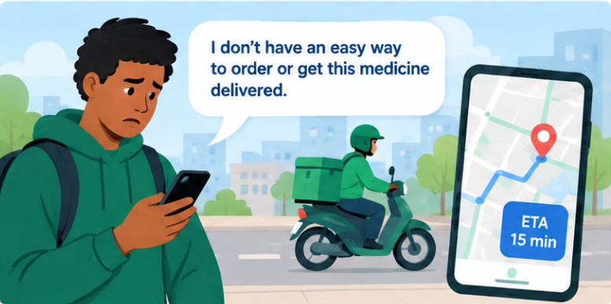
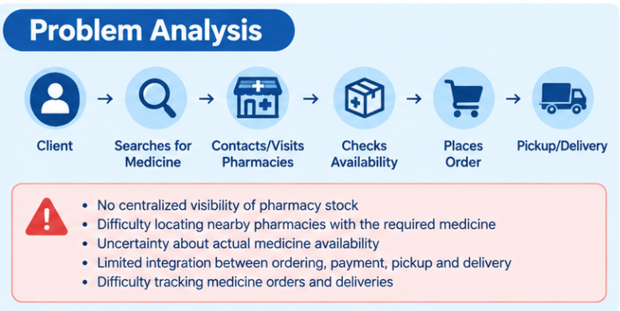

Slide 9

Problematics
This poses a critical question?
“How can a digital pharmacy stock management platform improve the visibility and reliability of medicine availability while enabling clients to locate nearby pharmacies, request and confirm orders, and obtain medicines through pickup or pharmacy-based delivery....”

Slide 10
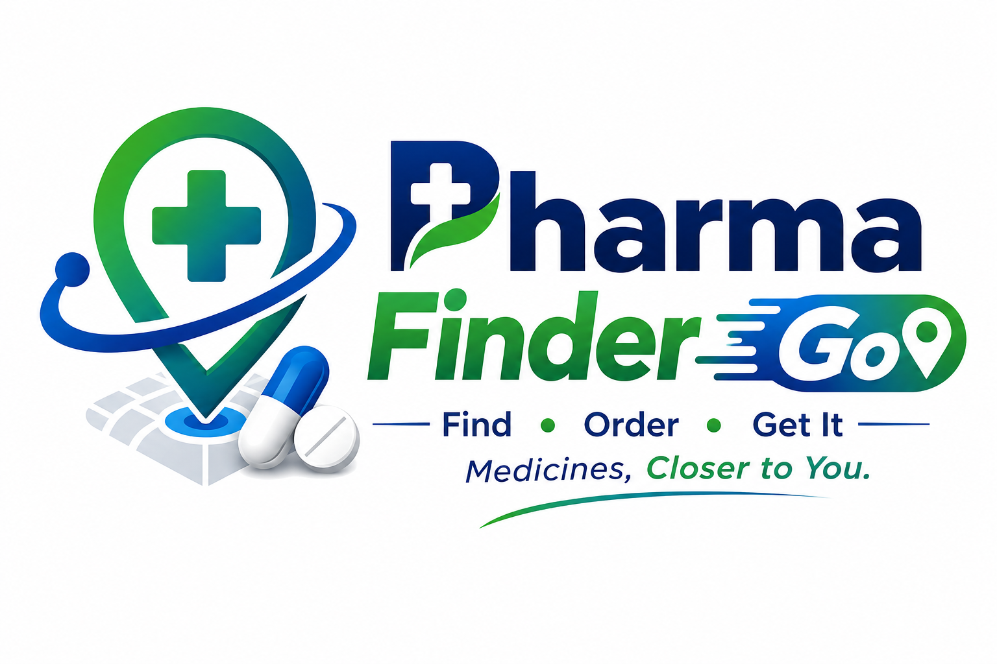
Proposed Solutions
The solution is PharmaGo, an AI-assisted pharmacy stock management platform that provides centralized stock management, geolocation-based drug search, order processing, and pickup or delivery services to improve access to medicines in Cameroon.
A. Centralized Pharmacy Stock Management Platform
Provides pharmacies with tools to:
Manage medicine stocks and quantities
Add, update and remove medicines
Improve visibility of listed medicine availability
B. Geolocation-Based Drug Search and Ordering
Allows clients to:
Search for medicines
Identify nearby pharmacies
View pharmacy location and availability
Place orders and upload prescriptions when required
C. Integrated Pickup, Delivery and Payment
Allows clients to:
Choose pickup or delivery
Pay through Mobile Money or Cash on Delivery
Track delivery status
Use routes and ETA through Google Maps

Slide 11
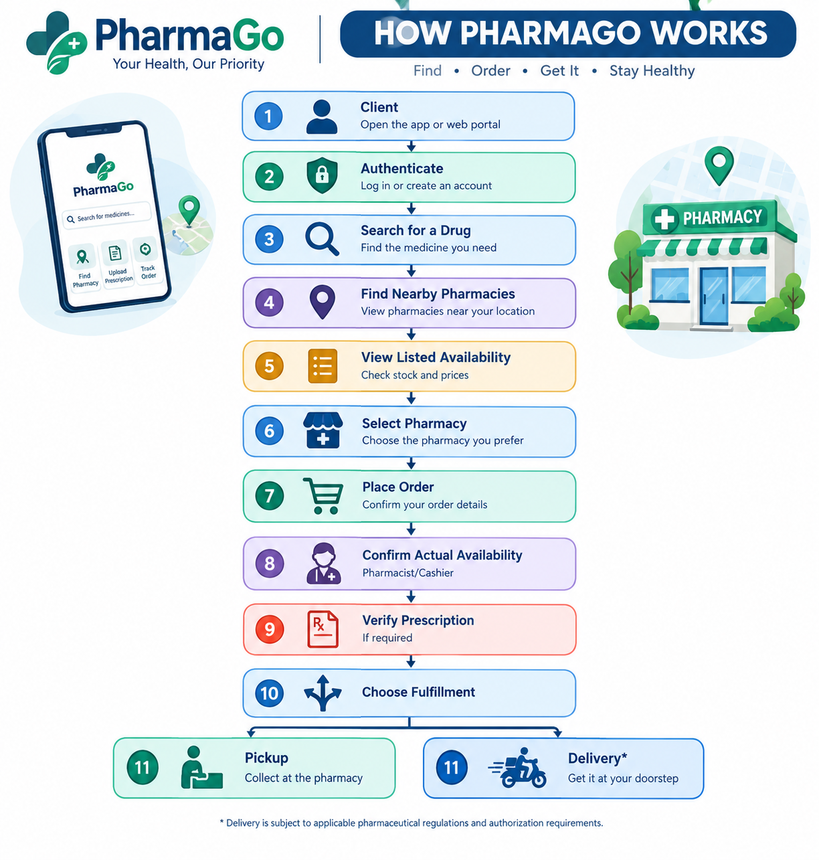
— HOW PHARMAGO WORKS

Slide 12
AI ASSISTANCE WITH GEMINI
WHAT GEMINI PROVIDES
ADVANTAGES
LIMITATIONS
Conversational interaction
General health information
Advisory symptom assistance
Natural-language responses
Fast interaction
Natural-language communication
Easy API integration
May produce incorrect information
Not a medical professional
Not a diagnostic tool
Requires internet/API availability
Only necessary information should be shared with the AI service. Sensitive data should be minimized, and API credentials must remain protected on the backend.Gemini assists the user, but it does not replace a pharmacist or healthcare professional.

Slide 13
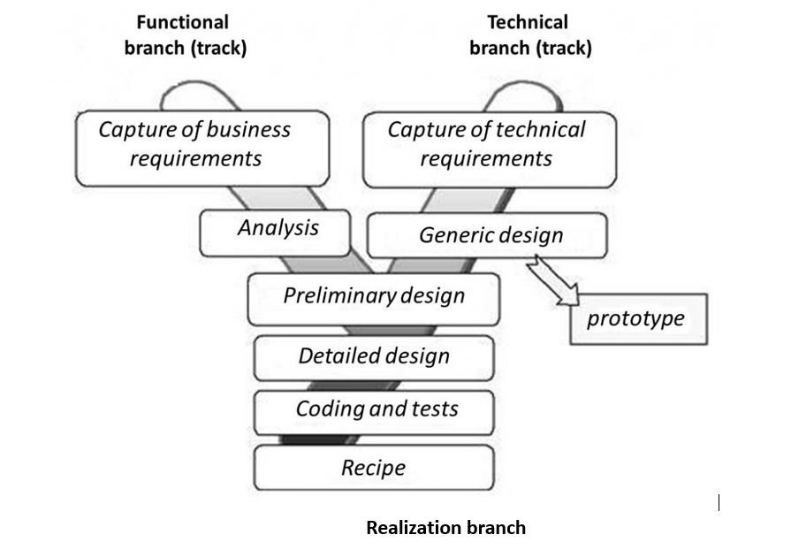

Methodology
2TUP

Slide 14
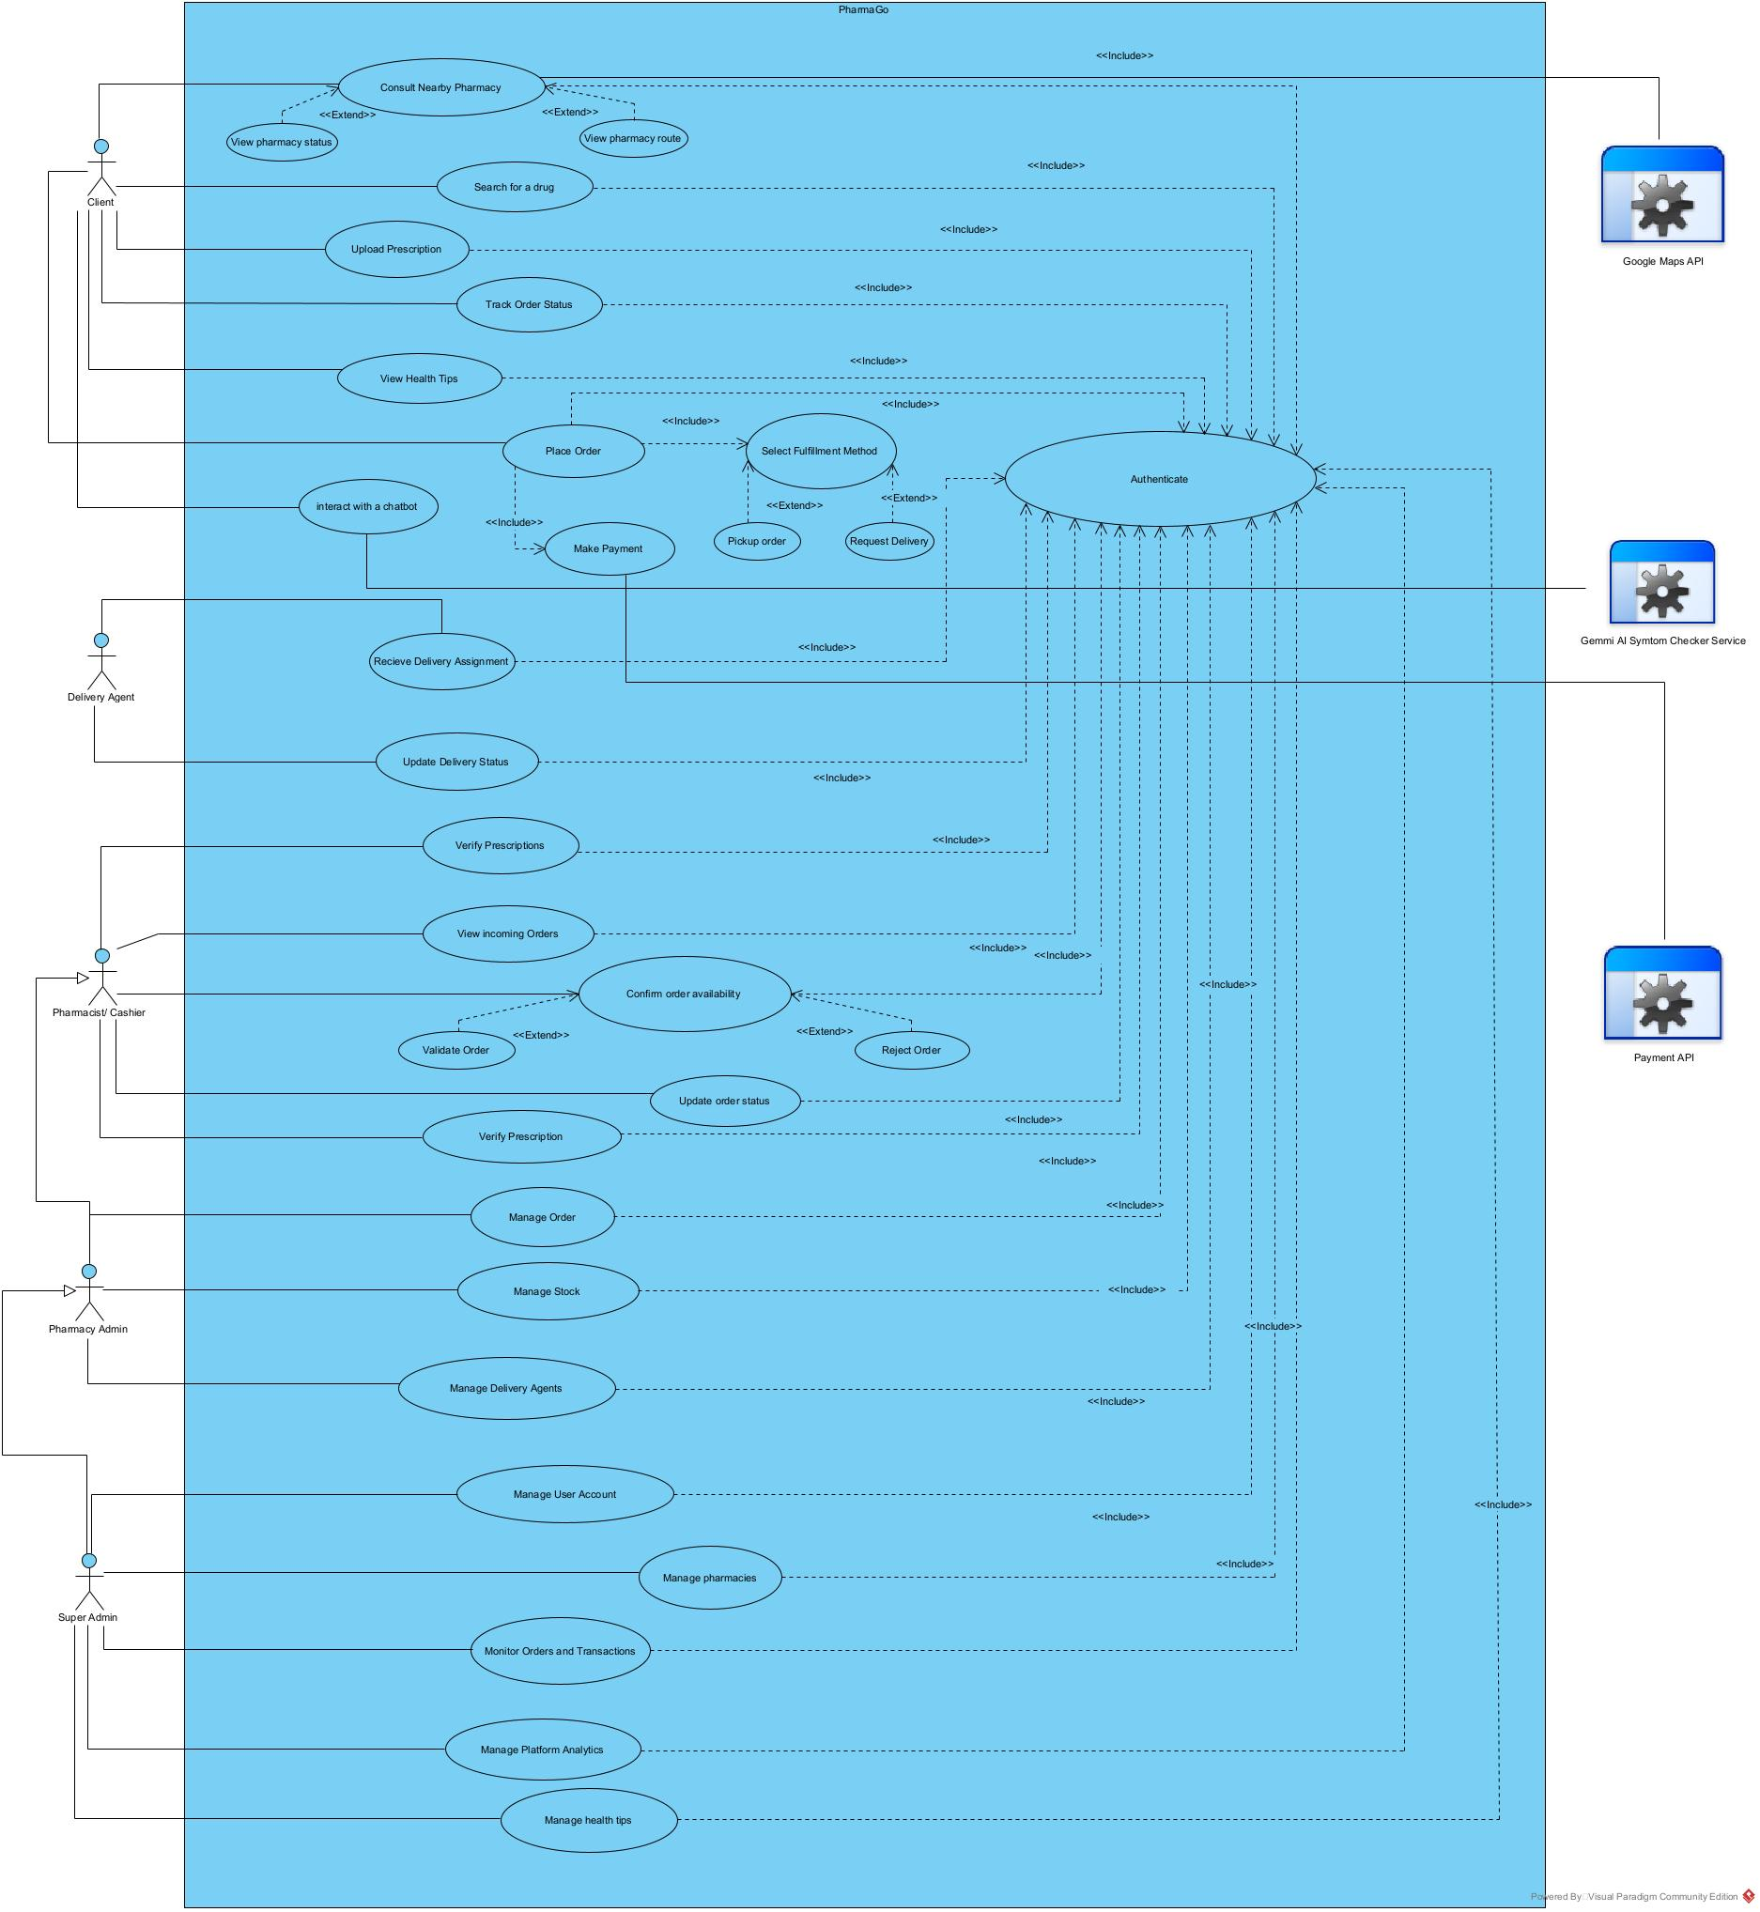
GENERAL USE CASE DIAGRAM

Slide 15
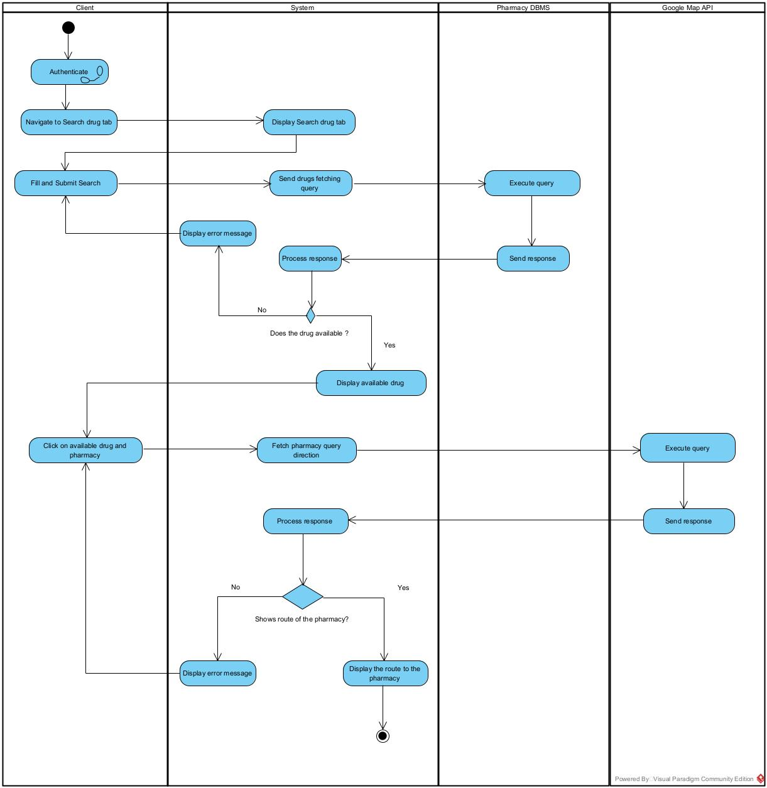
Activity Diagram of Search drug and pharmacy

Slide 16
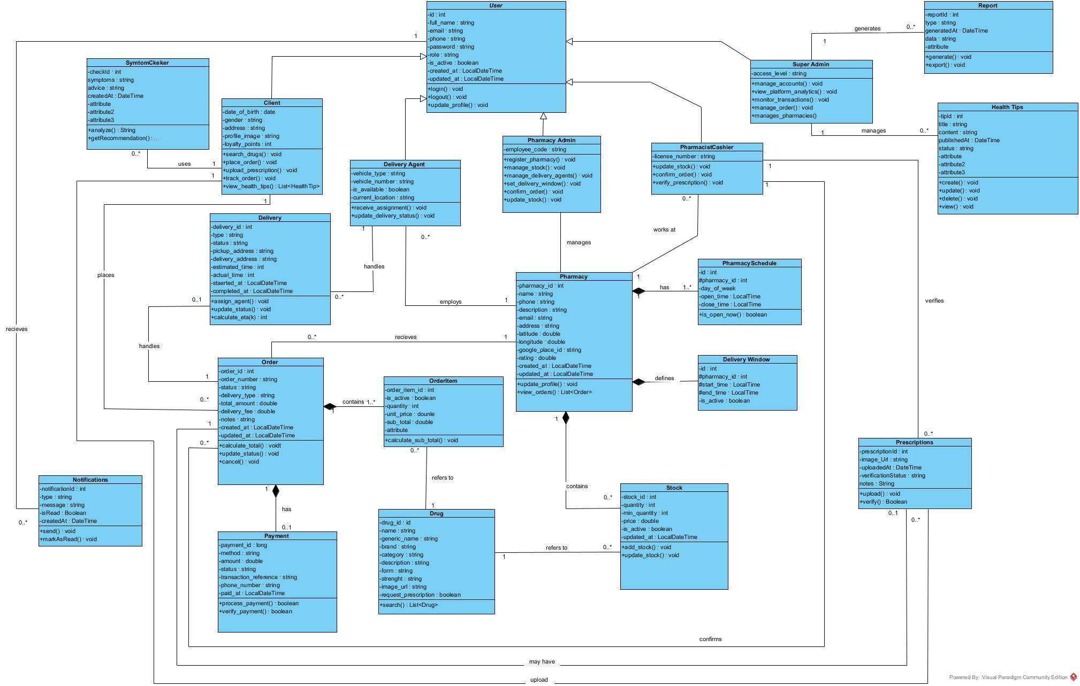
Class Diagram

Slide 17
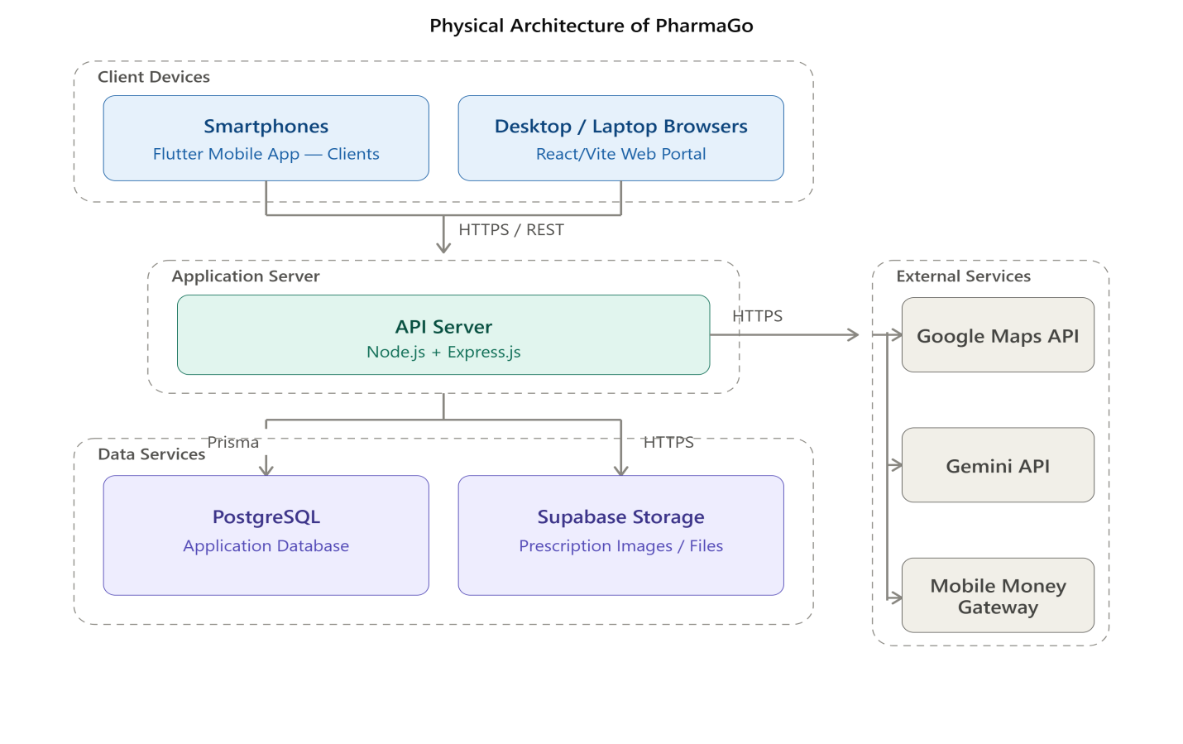
Methodology
N-tier Architecture
Technical branch
Capture of technical requirements
Generic design

Slide 18
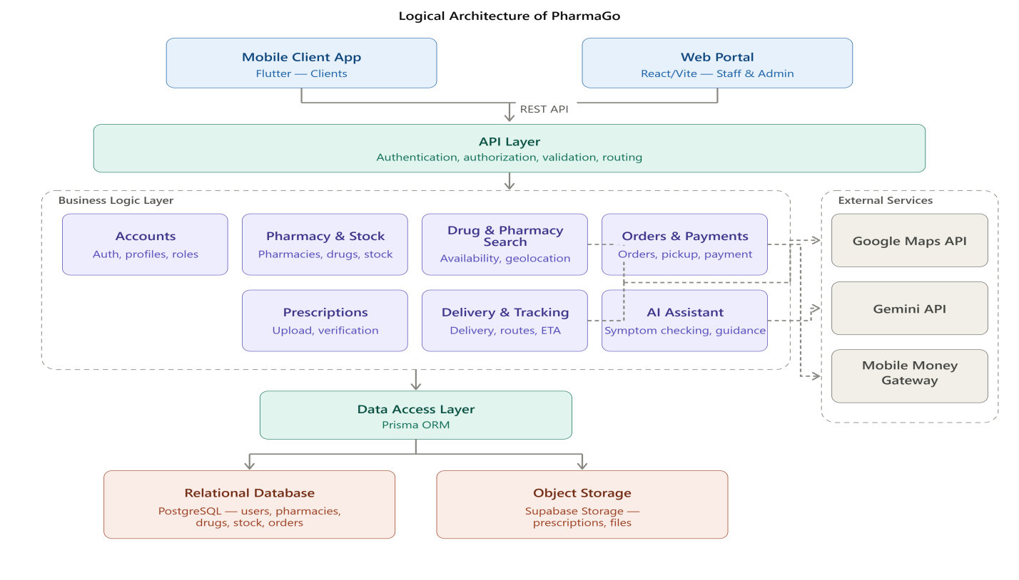
Methodology
Logical Architecture
Technical branch
Capture of technical requirements
Generic design

Slide 19
Security, Scalability & Regulatory Considerations
Security
Scalability
Regulatory
Authentication
Role-Based Access Control
HTTPS/TLS
Secure password hashing
Protected API credentials
Database access control
Audit trail for important operations
N-tier design
API scaling
DB optimization
Monitoring
Caching
DPML
Law 90/035
Pharmacy responsibility
Authorization required
Prototype ≠ authorization
PharmaGo is technically designed for secure and scalable operation, while real-world pharmaceutical delivery remains subject to applicable regulations and regulatory validation

Slide 20

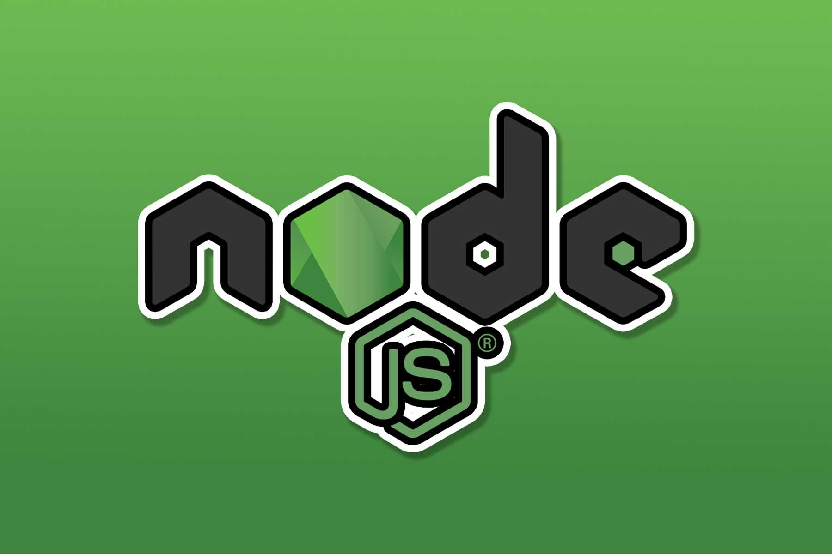

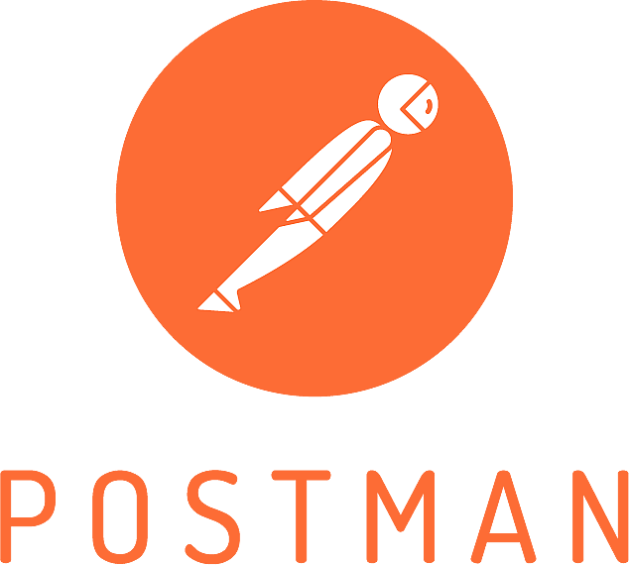





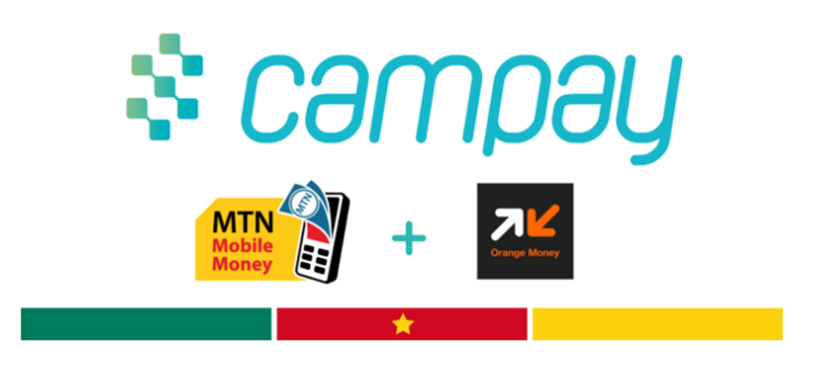


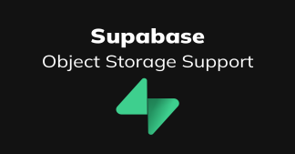

DEVELOPMENT TOOLS
Flutter
client mobile application
Node.js and Express.js
Server-side JavaScript runtime and Backend/API framework
Test and validate REST APIs
Visual Paradigm
Visual Studio
gemini ai
AI assistance
React and Vite
web portal
Payment Gateway
database
database access
prescription images
Google map
location/routes

Slide 21
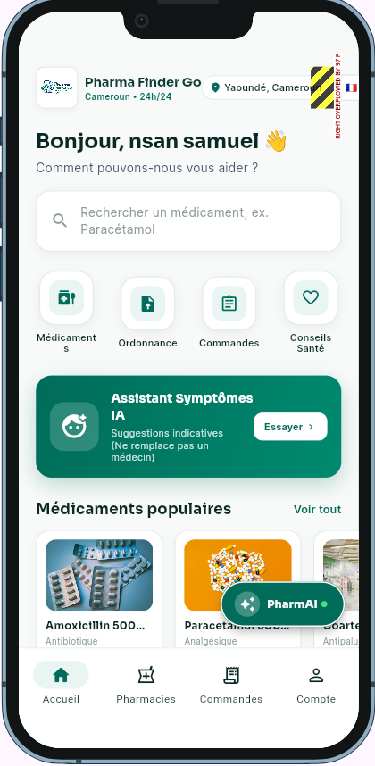


Demonstration

Slide 22
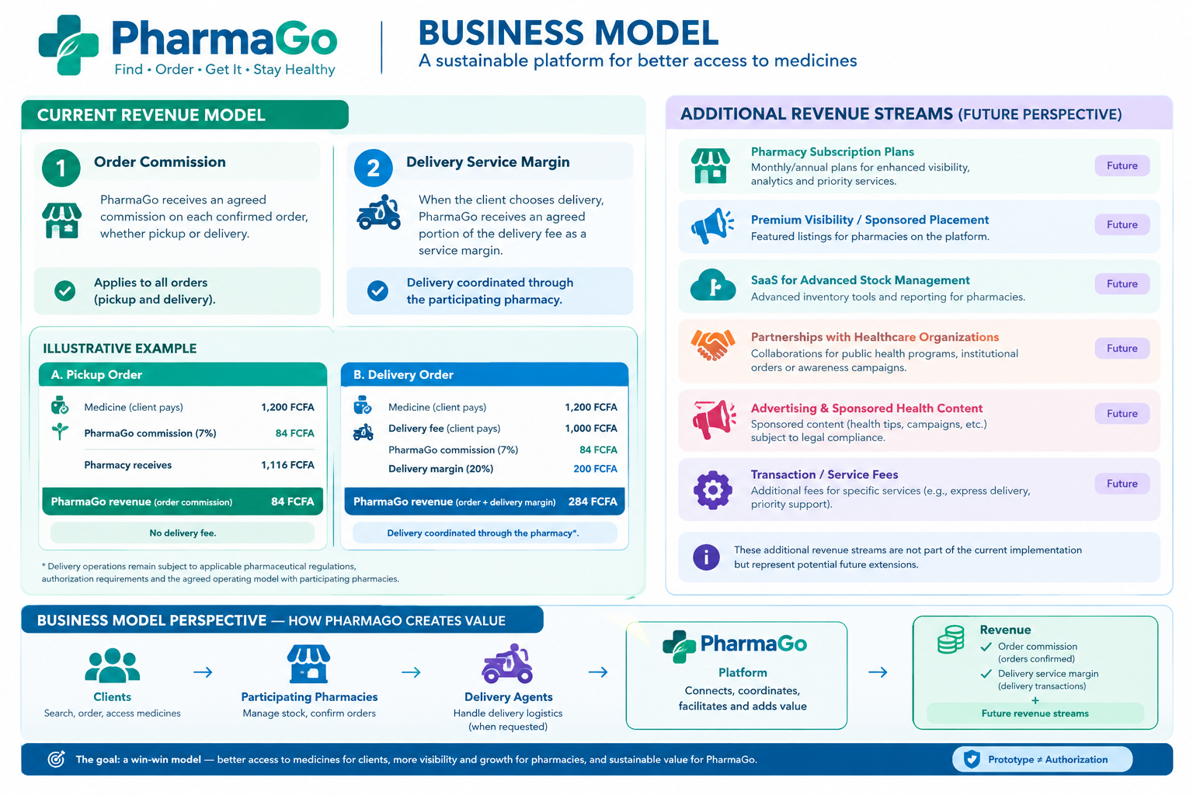

Slide 23

Thanks!

